Slide 1
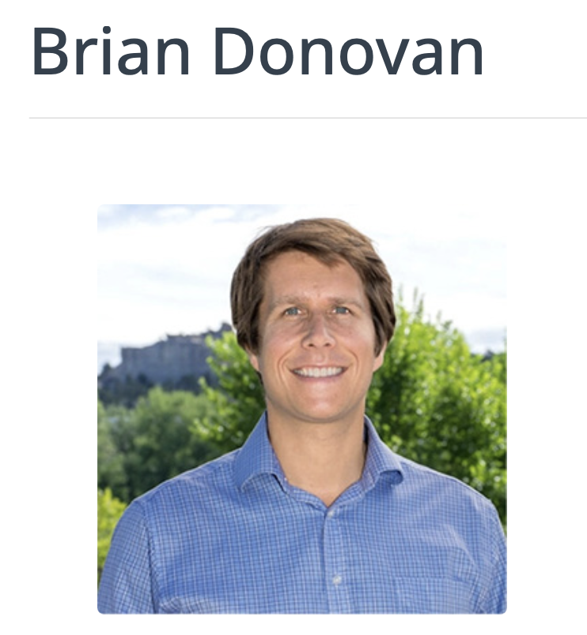
Humane genomics literacy
BA in Biology from Colorado College
MA in Teaching from San Francisco State
PhD in Science Education from Stanford
Teaching genetics in the traditional way exacerbates racism in the US
We could teach humane genomics instead

Slide 2
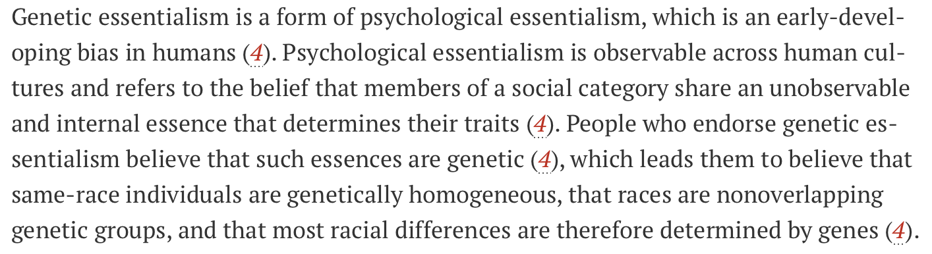
The problem
Donovan et al. 2024

Slide 3
An example of the problem: Genetic Diversity across Groups
If we imagine there are 3 ancestral groupings of humans and that each circle represents the total number of gene variants in the human genome found within a particular group, how much do they overlap (if at all)?
Draw what you imagine is the overlap? You can also make the circles larger or smaller to reflect the overall amount of diversity in a population.
African
Asian
White European

Slide 4
The answer surprises and confuses students with genetic essentialist beliefs about ancestry and genetics
White European
African
Asian
https://www.understandingrace.org/RaceAndHumanVariation

Slide 5
DNA variation across populations
Genetic variation in populations such as Europeans and Asians are subsets of the variation in the African population
African populations harbor some alleles that are absent in non-African populations. However, all the alleles that are found in non-African populations are also found in African populations
White
European
African
Asian
https://www.understandingrace.org/RaceAndHumanVariation
https://www.nature.com/articles/nature15393

Slide 6
Teach the paradox of human genetics
All human beings are 99.1% identical to each other in genetic sequence
Because the genome has more than a billion nucleotides, there is enough variation for applications such as forensic DNA testing.
0.1% of 3,200,000,000 = 3,200,000

Slide 7
Genetic Essentialism
Is a scientifically flawed worldview
…has been and continues to be used to justify racism
…has to be actively debunked
“…belief in genetic essentialism can be promoted or prevented depending on what we teach students about genetics and why we teach it. ”
Donovan et al 2021 and Donovan 2022

Slide 8
Basic genetics literacy
Almost always starts with Mendel, even though the discipline of genetics has evolved tremendously since
Emphasizes single-gene inheritance and simplified traits in standard constant environments (usually by omitting environmental impact entirely)
Emphasizes simple patterns of inheritance in family trees, such as “X-linked recessive.”
Donovan et al 2021a

Slide 9
Basic genetics literacy
Almost always includes over-simplified racialized instruction on alleles associated with severe human diseases
“…learning about monogenic diseases can cause greater belief in genetic essentialism of “race.”” (via RCT)
Does not directly address complex human traits such as race or intelligence
  Remains silent rather than address these matters
Does not debunk erroneous essentialist thinking and can even enhance it
Reinforces essentialist thinking about race and genes (K-16)
Donovan et al 2021; 2024

Slide 10
Standard genomics literacy
“…[teaches] population thinking and multifactorial genetics, but … not … how these ideas refute genetic essentialism.”
Is insufficient to debunk false essentialist genetic beliefs
Donovan et al 2021a; Donovan et lk, 2021b

Slide 11
References
Donovan et al. 2024. Humane genomics education can reduce racism. Science 383:818-822. DOI: 10.1126/science.adi7895
Donovan 2022. Ending genetic essentialism through genetics education. HGG Advances 3:100058. https://doi.org/10.1016/j.xhgg.2021.100058
Donovan et al. 2021a. How can we make genetics education more humane? In Genetics Education Current Challenges and Possible Solutions, edited by Michal Haskel-Ittah and Anat Yarden.
Donovan et al. 2021b. Genomics literacy matters: Supporting the development of genomics literacy through genetics education could reduce the prevalence of genetic essentialism. J Res Si Teach 58:520-550. https://doi.org/10.1002/tea.21670
Jamieson & Radick 2017. Genetic Determinism in the Genetics Curriculum. Sci & Educ 26, 1261–1290. https://doi.org/10.1007/s11191-017-9900-8
Bapty 2023. Must Introductory Genetics Start with Mendel? Sci & Educ 32: 1677–1708. https://doi.org/10.1007/s11191-022-00361-z
Koop 2022. https://arxiv.org/pdf/2207.11595

Slide 12
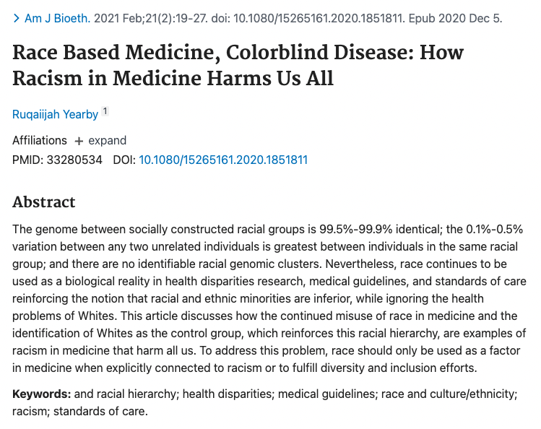
https://pubmed.ncbi.nlm.nih.gov/33280534/

Slide 13
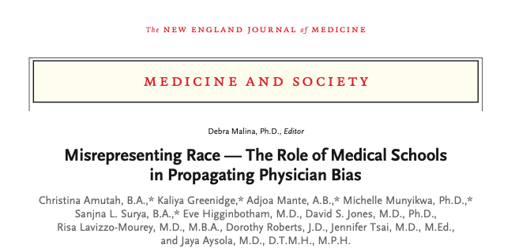
Published January 6, 2021
N Engl J Med 2021;384:872-878
DOI: 10.1056/NEJMms2025768
VOL. 384 NO. 9
https://www.nejm.org/doi/full/10.1056/NEJMms2025768

Slide 14
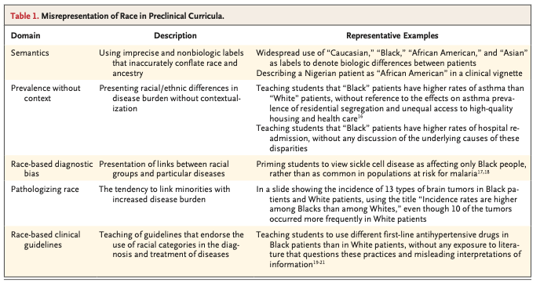
https://www.nejm.org/doi/full/10.1056/NEJMms2025768

Slide 15
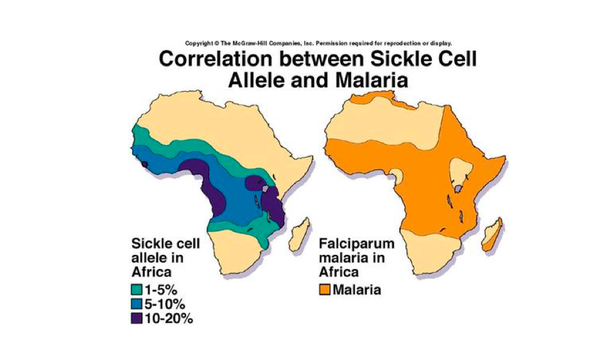
How biologization of race categories is taught: compare this slide with the next one.

Slide 18
*
U.S. Supreme Court
Loving v. Virginia, 388 U.S. 1 (1967)
Argued April 10, 1967 - Decided June 12, 1967
Syllabus
Virginia's statutory scheme to prevent marriages between persons solely on the basis of racial classifications held to violate the Equal Protection and Due Process Clauses of the Fourteenth Amendment.
Section 257 of the Virginia Code provides:
"Marriages void without decree. -- All marriages between a white person and a colored person shall be absolutely void without any decree of divorce or other legal process."
Va.Code Ann. § 20-57 (1960 Repl. Vol.).

Slide 19
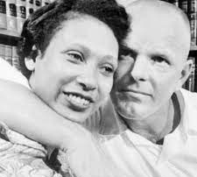
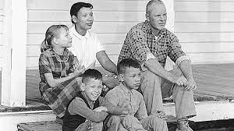
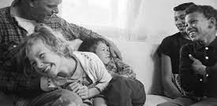
The Lovings Family

Slide 20
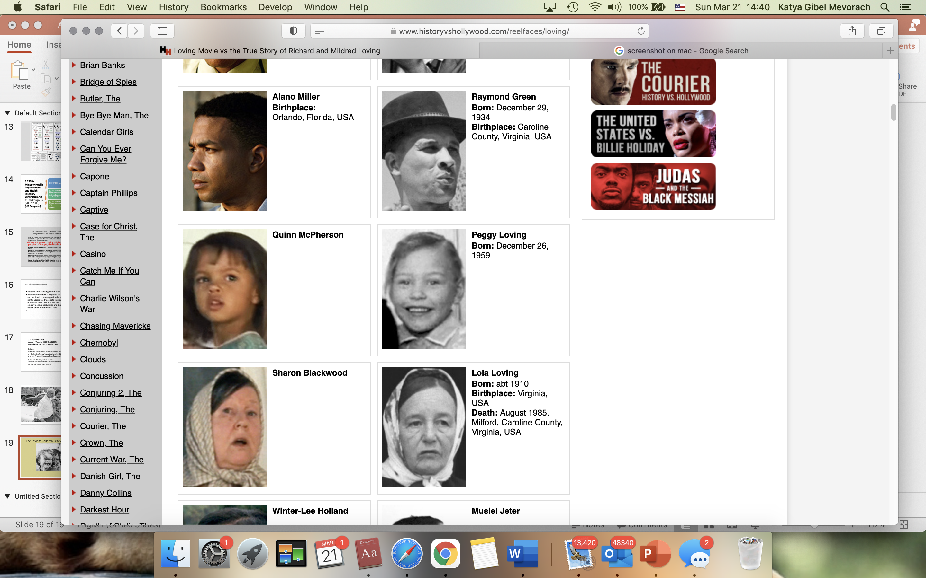
The Lovings Children Peggy, Donald, Sydney
dramatization and misleading casting

Slide 21
Misrepresentation v Inconvenient Truth

