Slide 1
SOME STRATEGIES FOR NOT TEACHING RACISM
Phoebe Lostroh, Colorado College
Leslie Gregg-Jolly, Grinnell College

Slide 2
Humane genomics literacy
“[teaches] how population thinking and multifactorial genetics refute genetic essentialism.”
Dismantles false essentialist genetic beliefs
Students can explain that “races” are not based in biology even though racism is real
Students can explain that racism is often justified through naïve and incorrect beliefs about “race” and genes
“Our cluster-randomized crossover trial is the first to explore how basic genetics versus humane genomics instruction affects racial conceptualization.”
Donovan et al 2021a; Donovan et al, 2021b; 2024
Notes:
Between December 2019 and May 2022, we recruited 15 teachers (n = 14 high school, n = 1 middle school) and 1063 biology students from six US states (Colorado, Illinois, Indiana, Kansas, New Jersey, and Massachusetts; see fig. S1). Participating teachers (see table S1) received 40 hours of professional development to learn how to implement the humane genomics intervention and how to align their Mendelian and molecular genetics curricula with basic genetics (i.e., mechanisms A to C). We randomized classrooms to receive six weeks of instruction in two different orders (figs. S1 and S2). Half of each teacher’s classrooms (n = 25) received basic genetics instruction first (for 3 weeks) that targeted mechanisms A to C outlined in the section on basic genetics. Then, these classrooms received humane genomics instruction (for 3 weeks) that targeted concepts D to F outlined in the section on humane genomics. The other half of each teacher’s classrooms (n = 26) received humane genomics first and then basic genetics instruction, using identical instructional materials for the same duration.

Slide 3
Donovan et al 2024 study design
15 teachers (n = 14 high school, n = 1 middle school) and 1063 biology students from six US states in 50 different classrooms
“The [curriculum] did not explicitly define or use the terms social constructionism, racial colorblindness, or genetic essentialism. Nor did it [teach] … arguments in favor of social constructionism. [E]ffects on racial conceptualization cannot be attributed to teaching to the test.”
“The curriculum and instruction did not define or use the term genetic essentialism. Second, [there was] no evidence of socially desirable reporting on the genetic essentialism instrument (see SM).”
They measured knowledge and beliefs about genetics and “race.”
Crossover design: basic genetics then humane genomics or vice versa
Notes:
Between December 2019 and May 2022, we recruited 15 teachers (n = 14 high school, n = 1 middle school) and 1063 biology students from six US states (Colorado, Illinois, Indiana, Kansas, New Jersey, and Massachusetts; see fig. S1). Participating teachers (see table S1) received 40 hours of professional development to learn how to implement the humane genomics intervention and how to align their Mendelian and molecular genetics curricula with basic genetics (i.e., mechanisms A to C). We randomized classrooms to receive six weeks of instruction in two different orders (figs. S1 and S2). Half of each teacher’s classrooms (n = 25) received basic genetics instruction first (for 3 weeks) that targeted mechanisms A to C outlined in the section on basic genetics. Then, these classrooms received humane genomics instruction (for 3 weeks) that targeted concepts D to F outlined in the section on humane genomics. The other half of each teacher’s classrooms (n = 26) received humane genomics first and then basic genetics instruction, using identical instructional materials for the same duration.

Slide 4
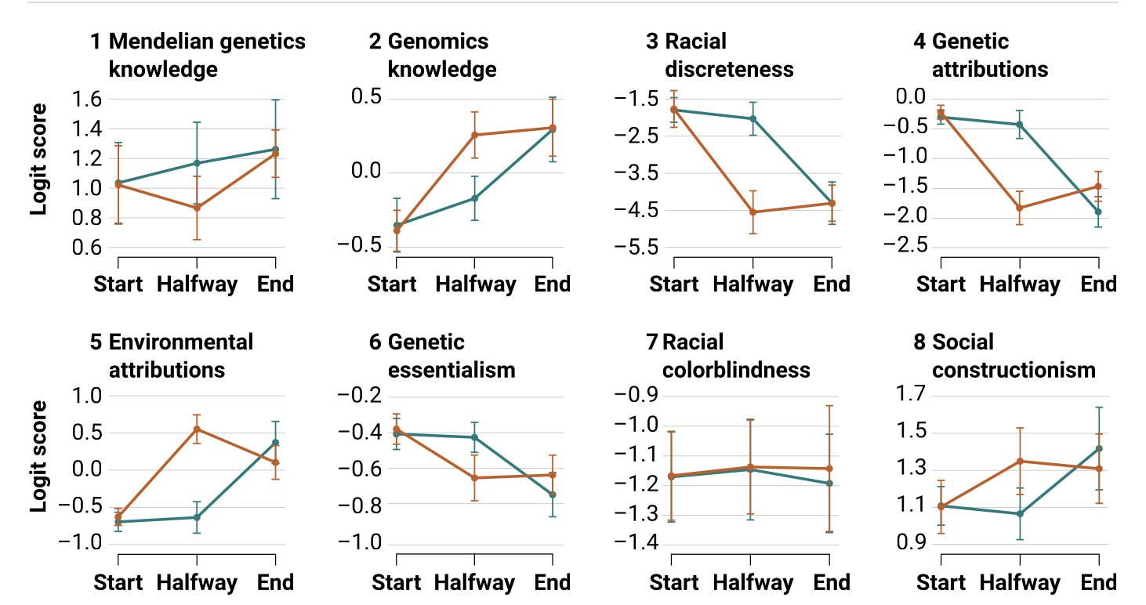
Humane genomics literacy RCT
Humane genomics first, then basic genetics
Basic genetics first, then humane genomics
Donovan et al 2024
Notes:
The logit function is mathematically defined as the logarithm of the odds of the probability p of a certain event occurring: Logit(p) = log(p / (1 - p)) Here, p represents the probability of the event, and log denotes the natural logarithm.

Slide 5
Humane genomics literacy reduces racist beliefs
Humane genomics first
Basic genetics first
Donovan et al 2024
Notes:
Complete case analysis of treatment effects for the crossover trial
Means and Bonferroni-adjusted 95% confidence intervals from a three-level mixed-effects regression are shown for classes that first received humane genomics instruction followed by basic genetics (orange) or basic genetics followed by humane genomics (blue).

Slide 6
Humane genomics literacy reduces racist beliefs
Humane genomics first
Basic genetics first
Donovan et al 2024
Notes:
Complete case analysis of treatment effects for the crossover trial
Means and Bonferroni-adjusted 95% confidence intervals from a three-level mixed-effects regression are shown for classes that first received humane genomics instruction followed by basic genetics (orange) or basic genetics followed by humane genomics (blue).

Slide 7
Humane genomics literacy increases knowledge of the social construction of ”race.”
Humane genomics first
Basic genetics first
Donovan et al 2024
Notes:
First, the curriculum and instruction involved in the humane genomics condition did not define or use the term genetic essentialism. Second, we estimated the presence and magnitude of social desirability bias on the baseline survey in the crossover trial using a method called a list experiment. This method revealed no evidence of socially desirable reporting on the genetic essentialism instrument (see SM).

Slide 8
The good news
“… [teachers] can protect students from believing in unscientific notions of genetic essentialism and support their scientifically accurate understanding of race as a social construction.”
Donovan et al. 2024

Slide 9
References
Donovan et al. 2024. Humane genomics education can reduce racism. Science 383:818-822. DOI: 10.1126/science.adi7895
Donovan 2022. Ending genetic essentialism through genetics education. HGG Advances 3:100058. https://doi.org/10.1016/j.xhgg.2021.100058
Donovan et al. 2021a. How can we make genetics education more humane? In Genetics Education Current Challenges and Possible Solutions, edited by Michal Haskel-Ittah and Anat Yarden.
Donovan et al. 2021b. Genomics literacy matters: Supporting the development of genomics literacy through genetics education could reduce the prevalence of genetic essentialism. J Res Si Teach 58:520-550. https://doi.org/10.1002/tea.21670
Jamieson & Radick 2017. Genetic Determinism in the Genetics Curriculum. Sci & Educ 26, 1261–1290. https://doi.org/10.1007/s11191-017-9900-8
Bapty 2023. Must Introductory Genetics Start with Mendel? Sci & Educ 32: 1677–1708. https://doi.org/10.1007/s11191-022-00361-z
Koop 2022. https://arxiv.org/pdf/2207.11595

Slide 10
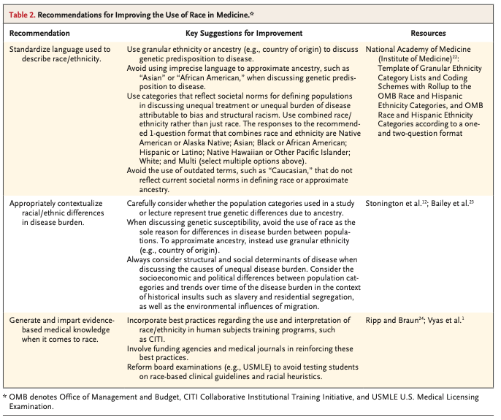
https://www.nejm.org/doi/full/10.1056/NEJMms2025768

Slide 11
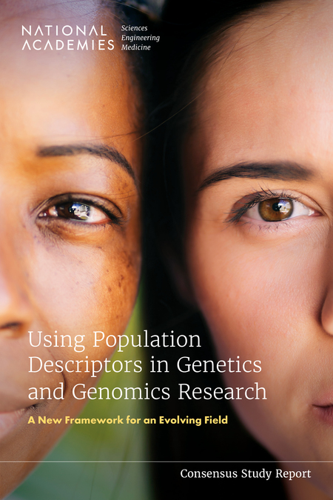
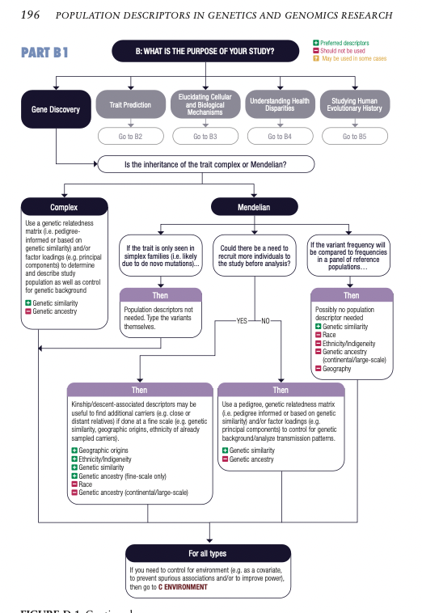
2023
https://nap.nationalacademies.org/catalog/26902/using-population-descriptors-in-genetics-and-genomics-research-a-new

Slide 12
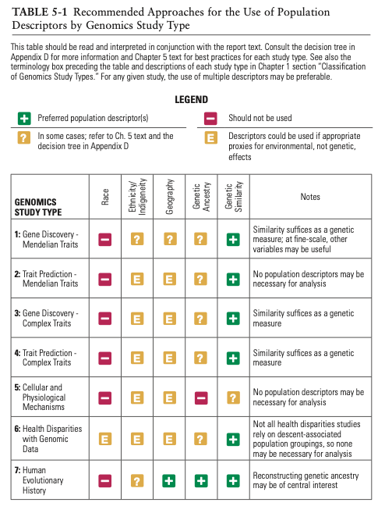
https://nap.nationalacademies.org/catalog/26902/using-population-descriptors-in-genetics-and-genomics-research-a-new

Slide 13
OTHER IDEAS?

