Slide 1
Racial Categories
Katya Gibel Mevorach

Slide 2
“Unteaching racism”
Historicizing:
  Concept of “race” – an idea not a thing
  Assigning People to Race Categories
  Vocabulary & (Un)Thinking

Slide 3
Racism is first and foremost a social practice – an action
Racism always takes its principal unit and core concept race for granted as objective reality;
BUT
*race is NOT an objective reality
* race categories = a system of classification
racism IS a reality
racism IS a reality with consequences

Slide 4
*
THE BRITISH COLONIES – Defining Property
Ancestry – Not Color
Whereas some doubts have arisen whether children got by any Englishman upon a Negro woman should be slave or free, be it therefore enacted and declared by this present Grand Assembly, that all children born in this country shall be held bond or free only according to the condition of the mother; and that if any Christian shall commit fornication with a Negro man or woman, he or she so offending shall pay double the fines imposed by the former act.
Act XII, Laws of Virginia, December 1662 (Hening, Statutes at Large, 2: 170

Slide 5
RACING
Willful Ignorance:
Look at the U.S. Census categories throughout the decades handout.
Share observations. -
Attention to the 1790 Census directions to enumerators.
Is this statement True or False:
"A person's race originated with the 1790 Census."

Slide 6
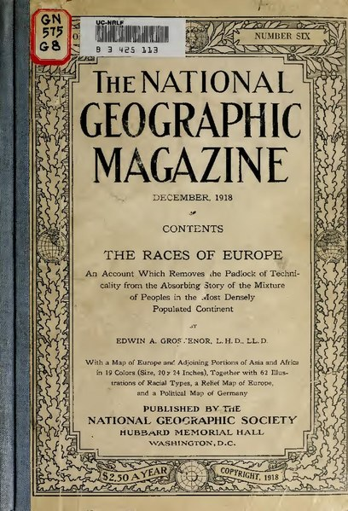
Author | Grosvenor, Edwin A. (Edwin Augustus), 1845-1936
Title | The races of Europe ; an account which removes the padlock of technicality from the absorbing story of the mixture of peoples in the most densely populated continent
Notes:
https://commons.wikimedia.org/wiki/File:The_races_of_Europe_;_an_account_which_removes_the_padlock_of_technicality_from_the_absorbing_story_of_the_mixture_of_peoples_in_the_most_densely_populated_continent_%28IA_racesofeuropeacc00grosrich%29.pdf

Slide 7

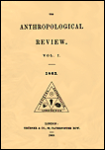
1864 - anthropology
On Human Hair as a Race-Character, Examined by the Aid of the Microscope
Dr. Pruner-Bey
The Anthropological Review, Vol. 2, No. 4 (Feb., 1864), pp. 1-23
On the Skin, the Hair, and the Eyes, as Tests of the Races of Man
John Crawfurd
Transactions of the Ethnological Society of London, Vol. 6 (1868), pp. 144-149

Slide 8
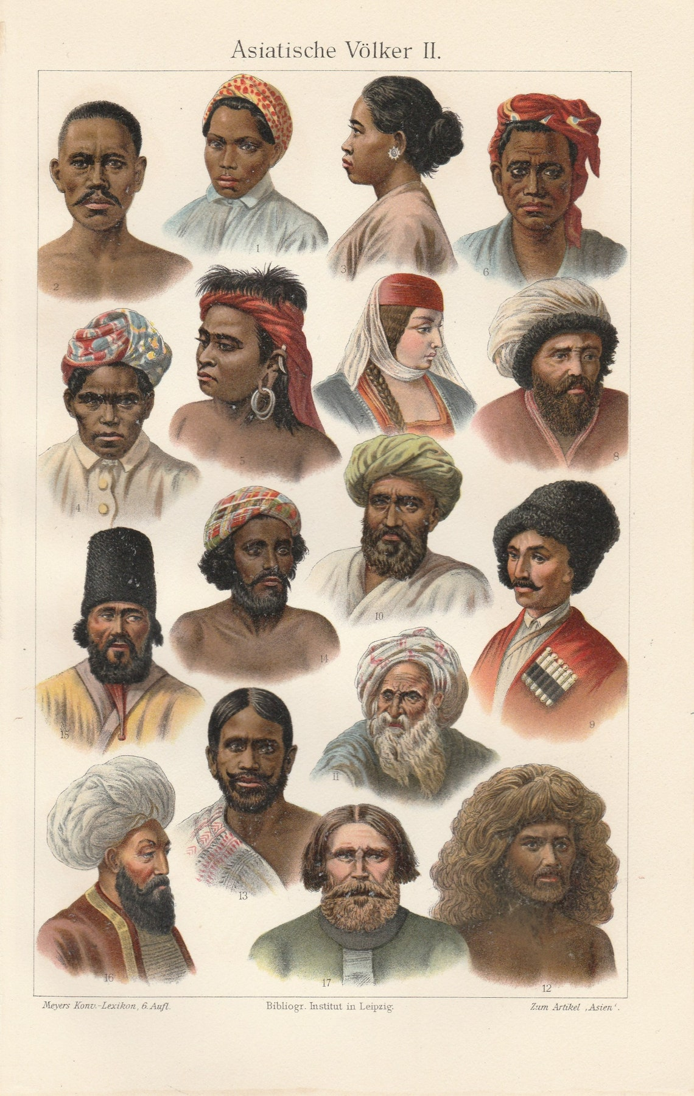
1902: Asian People Jew Cossack Persian Hindu Arab Celebes Batavian Georgian
Original Antique
Lithograph Print Ethnography Anthropology Asia
Notes:
https://www.etsy.com/listing/1677095215/1902-asian-people-jew-cossack-persian?click_key=56d08e6f060938d6d3f321dd00d68fbdba707a7f%3A1677095215&click_sum=cd155d35&ref=landingpage_similar_listing_bot-4&pro=1&listing_id=1677095215&listing_slug=1902-asian-people-jew-cossack-persian

Slide 9
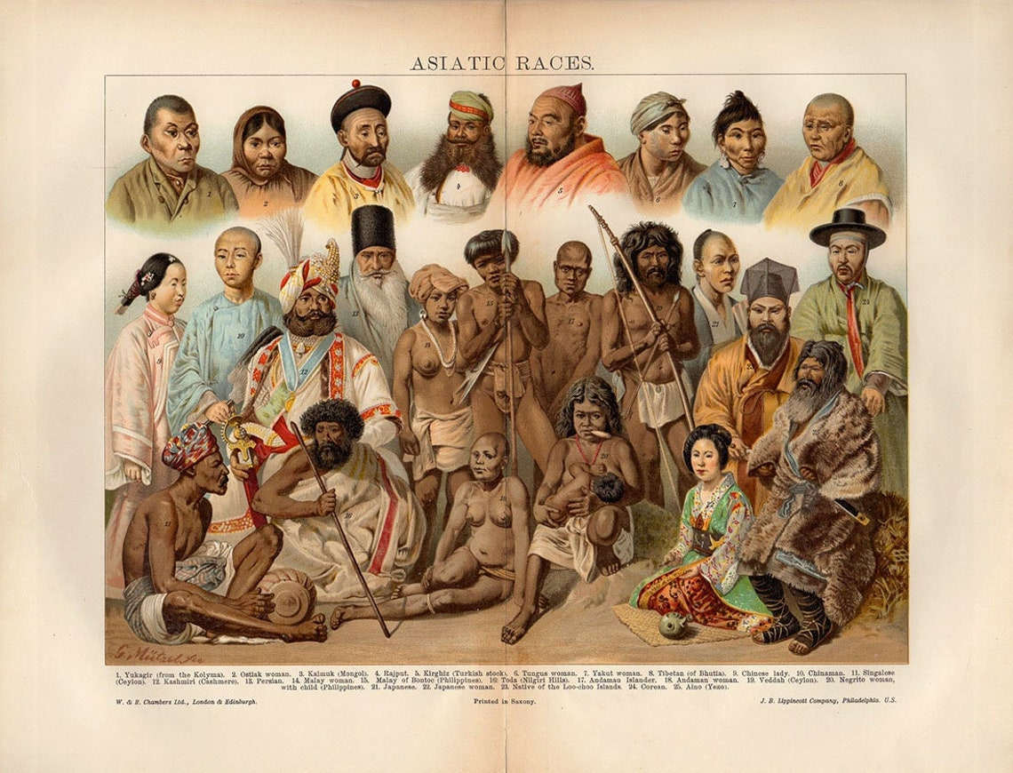
ASIATIC RACES, 1908 print, lithograph, aboriginal wall art vintage indigenous native culture illustration antique print
Notes:
https://www.etsy.com/listing/1100820802/asiatic-races-1908-print-lithograph?ga_order=most_relevant&ga_search_type=all&ga_view_type=gallery&ga_search_query=asian+races&ref=sr_gallery-1-23&content_source=8cb3df10d511dc3d4a7dd82bcc2c53d3fc8d93f6%253A1100820802&organic_search_click=1

Slide 10
Which child here is Black?
How do you know?
Which child is African-American?
How do you know?
Which child is a free person?
How do you know?
"Isaac & Rosa, slave children from New Orleans." M.H. Kimball, photographer. Albumen print on carte de visite, c. 1863.Credit Library of Congress

Slide 11
*

Slide 13
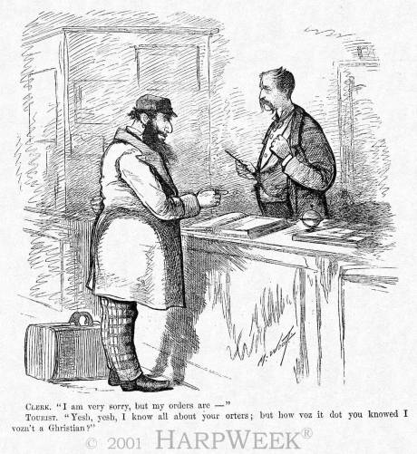
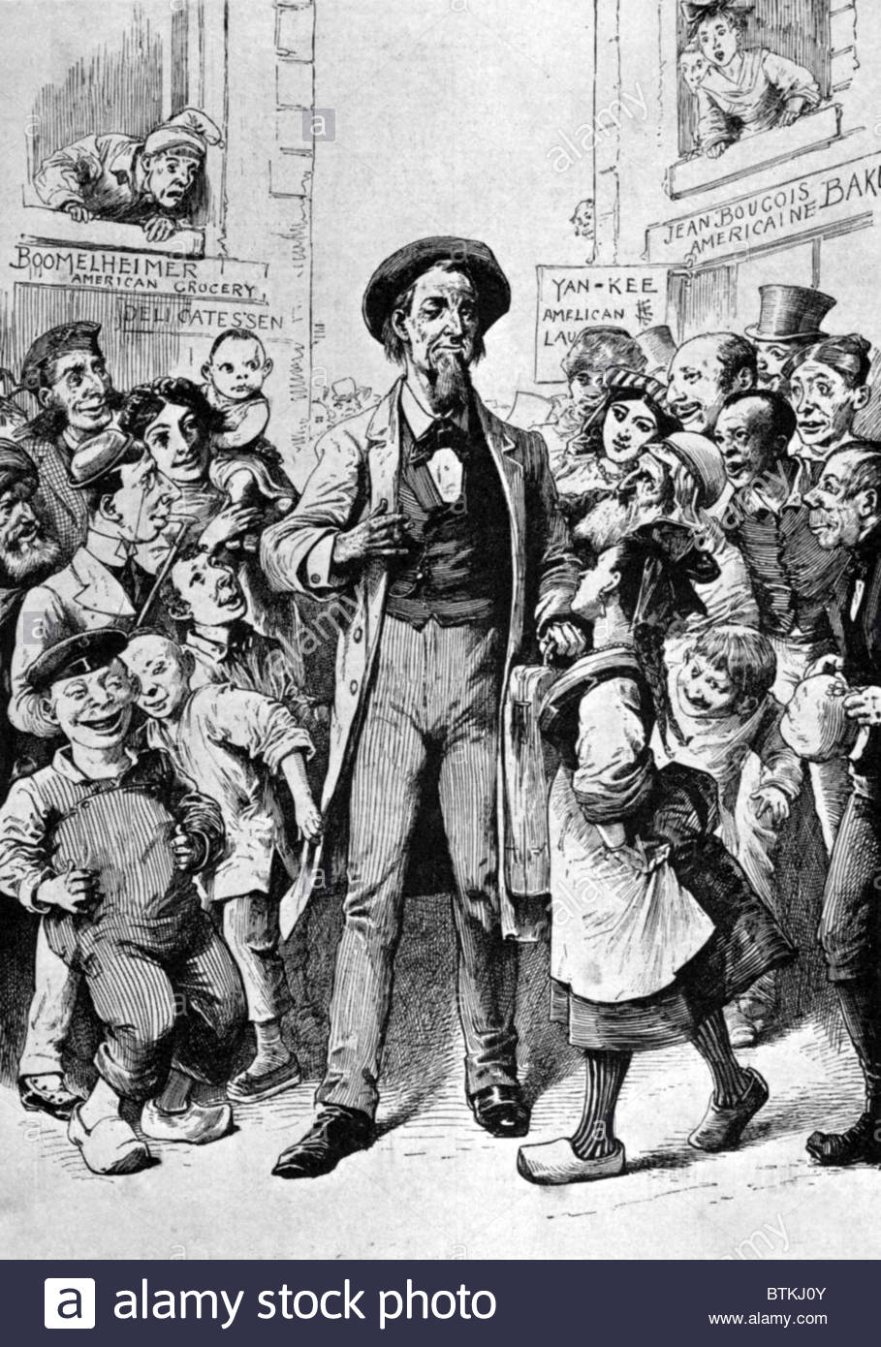

Slide 14
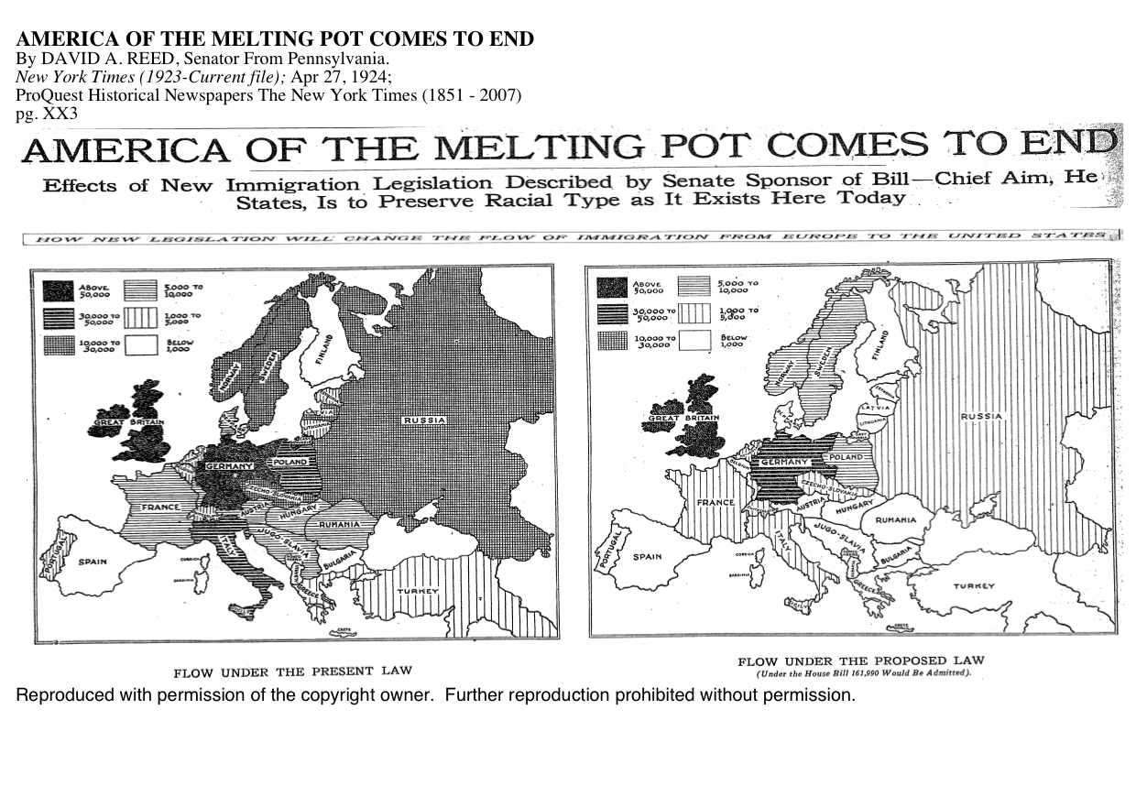

Slide 15
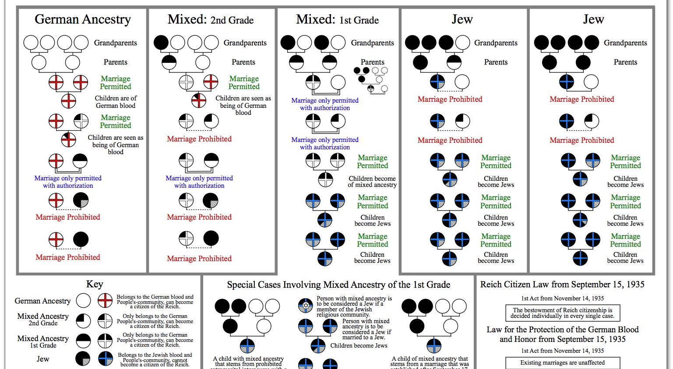

Slide 16
What is mixed race?
Myths are hard to unlearn because they are taught over and over again in many ways:
vocabulary
representations
in the performing arts; in commercial images

Slide 17
*
U.S. Supreme Court
Loving v. Virginia, 388 U.S. 1 (1967)
Argued April 10, 1967 - Decided June 12, 1967
Syllabus
Virginia's statutory scheme to prevent marriages between persons solely on the basis of racial classifications held to violate the Equal Protection and Due Process Clauses of the Fourteenth Amendment.
Section 257 of the Virginia Code provides:
"Marriages void without decree. -- All marriages between a white person and a colored person shall be absolutely void without any decree of divorce or other legal process."
Va.Code Ann. § 20-57 (1960 Repl. Vol.).

Slide 18
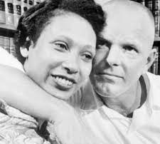
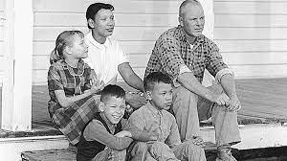
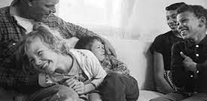
The Lovings Family

Slide 19
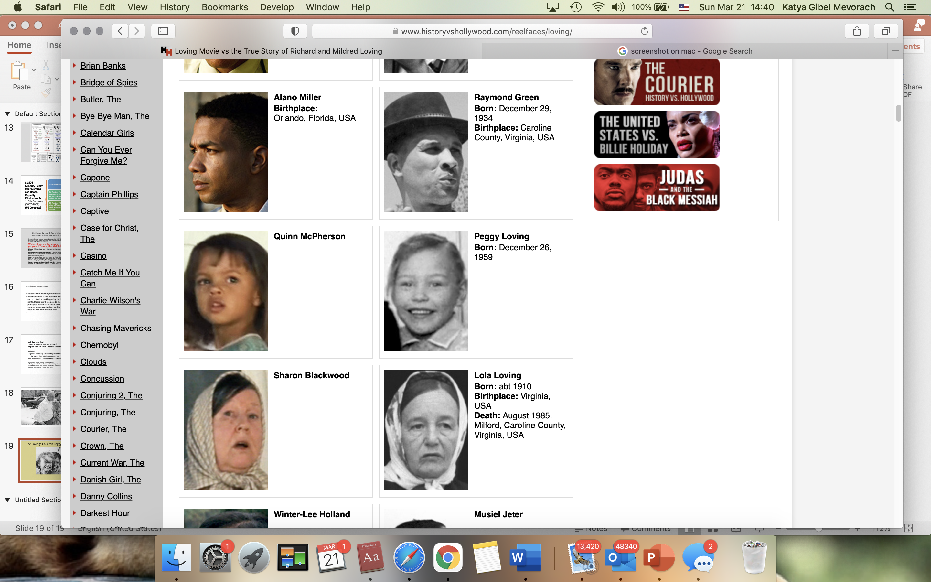
The Lovings Children Peggy, Donald, Sydney
dramatization and misleading casting

Slide 20
Misrepresentation v Inconvenient Truth

Slide 21
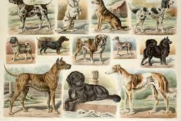
Top 10 des races de chiots préférées des Français en 2020 - WanimoVéto
Creator: rawpixel.com | Credit: Rawpixel.com - stock.adobe.com
Copyright: ©Rawpixel.com - stock.adobe.com

Slide 22
Myths are hard to unlearn because they are taught over and over again in many ways:
  vocabulary
  representations
  in the performing arts; in commercial images
  genetics
  medicine
Notes:
Phoebe?

Slide 23
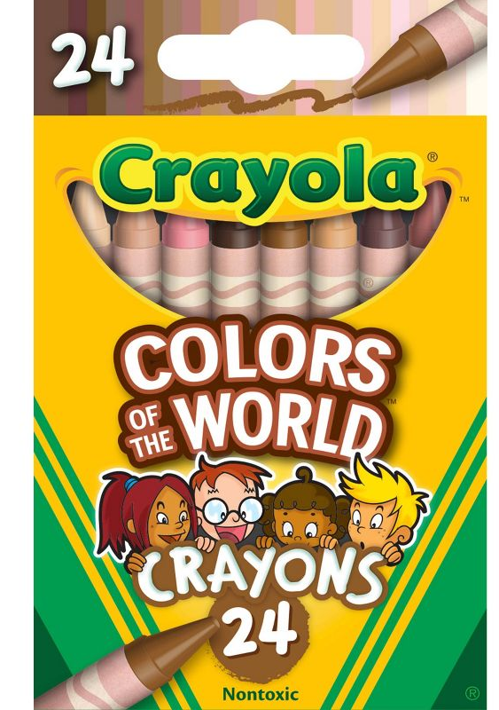
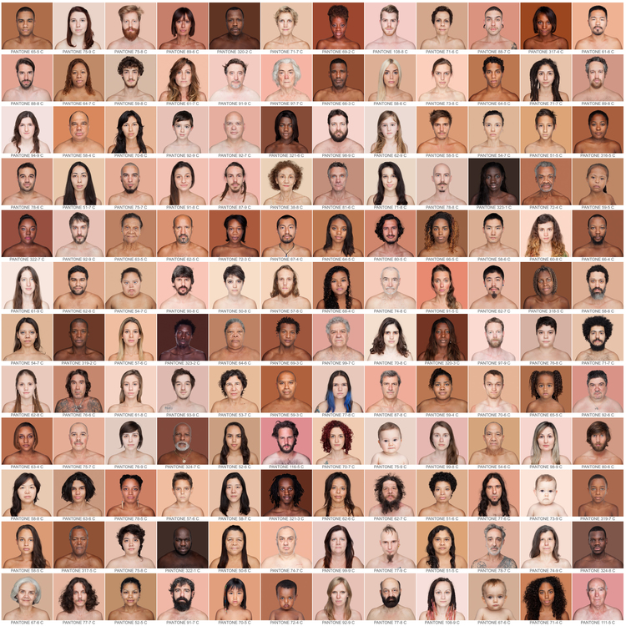

Slide 24
1. Create racial taxonomy
2. Create criteria
3. Rationale
4. Put the categories into a hierarchy

