Slide 1
BIOLOGY, TAXONOMY, AND MYTHS OF DISTINCTION
THERE ARE NOT BIOLOGICALLY DISTINCT GROUPS OF PEOPLE THAT HAVE ANY SOCIAL MEANING
Leslie A. Gregg-Jolly
Douglas D. Johnson ’77 Professor of Biology
Grinnell College

Slide 2
Modern Genetics Allows:
The quantification of genetic differences between populations in an objective fashion that can be applied to all species.
The reconstruction of recent evolutionary history by examining the evolutionary history of DNA regions in the genome within a species.
Direct to consumer ancestry testing
  is based on comparing customer sequences to sequences of modern people from different geographic regions.
Genetic studies looking at human difference focus on the limited parts of the genome that have the most variability.
Alan Templeton BIO220 2021

Slide 3
Genetic studies looking at differentiation between groups focus on the limited parts of the genome that vary.

Slide 4
What if there were distinct groups of humans?
What if there weren’t?
Genetic differentiation between groups

Slide 5
GENETIC
DIFFERENTIATION
DISTANCE
Alan Templeton BIO220 2021

Slide 6
FIGURE 1
Genetic differentiation between populations is continuous.
GENETIC
DIFFERENTIATION
DISTANCE
Alan Templeton BIO220 2021

Slide 7
Poor sampling falsely indicates distinct groups

Slide 8
Population sampling
Limited samples in a continuous population can create the misperception of discrete groups
Cluster
Cline
FIGURE 1 | (A) The effect of sampling strategies (adopted from Handley et al. 2007) [“Heterogeneous sampling can reveal genetic clusters that are biologically meaningless. The gradation in color from blue to orange represents a hypothetical situation of strictly continuous variation in allele frequencies. If sampling is heterogeneous (population samples represented here by circles) then the pattern of clinal variation can be mistaken for genetically distinct clusters (black ellipses)”] (Handley et al., 2007). (B) Global genetic diversity in humans are distributed in gradients among and within continents, emphasizes intercontinental variation. The inset figure of Africa highlights finer gradations over shorter geographic spans, emphasizing the “clinality” of human genetic variation (adopted from Cavalli-Sforza et al., 1994). Figure reproduced with permission from Cell Press/Elsevier.
Maglo KN, Mersha TB, Martin LJ. Population Genomics and the Statistical Values of Race: An Interdisciplinary Perspective on the Biological Classification of Human Populations and Implications for Clinical Genetic Epidemiological Research. Front Genet. 2016 Feb 17;7:22. doi: 10.3389/fgene.2016.00022

Slide 9
A level of genetic differentiation is needed to define a group
Genetic studies looking at differentiation between groups focus on the limited parts of the genome that vary.
To be a subspecies, differentiation should be above a threshold (25%).

Slide 10
A level of genetic differentiation is needed to define a group
To be a subspecies, differentiation should be above a threshold (25%).

Slide 11
Differences between groups of humans fall way below the 25% threshold.
What if a subgroup isn’t that different genetically but recently evolved independently?
Test this with level of ”treeness”

Slide 12
”trees” are used to show evolutionary relatedness (phylogeny)
Are lizards more closely related to salamanders or people?
Common ancestor to ALL lizards, armadillos & humans

Slide 13
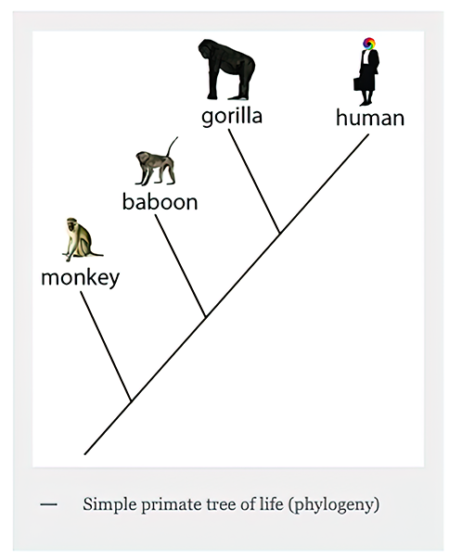
Are baboons more closely related to monkeys or to gorillas?
http://evolutionoutreach.org/activities-2/, with credit to the artist Oyoram for the human figure

Slide 14
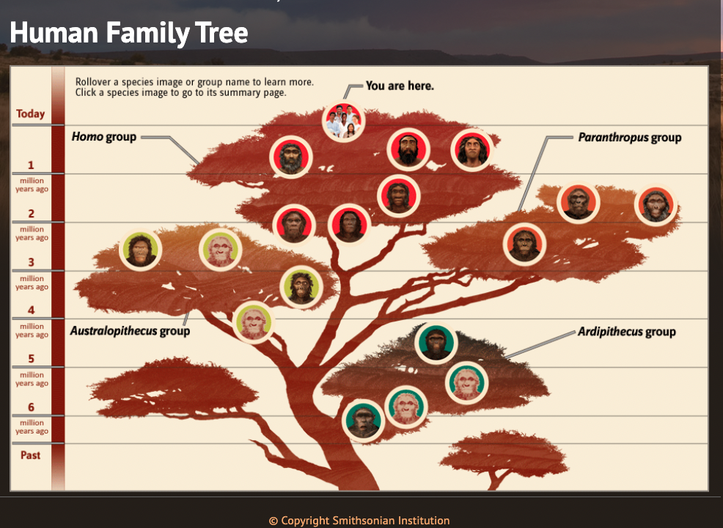
The increasingly bushy human family tree
https://humanorigins.si.edu/evidence/human-family-tree

Slide 15
Human evolution is a trellis indicating gene flow, not a tree of distinct lines of descent
Genetic information indicates that lines have not been evolving independently. There is no evidence of splitting. This is indicated by the horizontal lines in this figure.
None of the statistical analyses of genetic differentiation between human populations supports an evolutionary tree structure.
Alan Templeton BIO220 2021

Slide 16
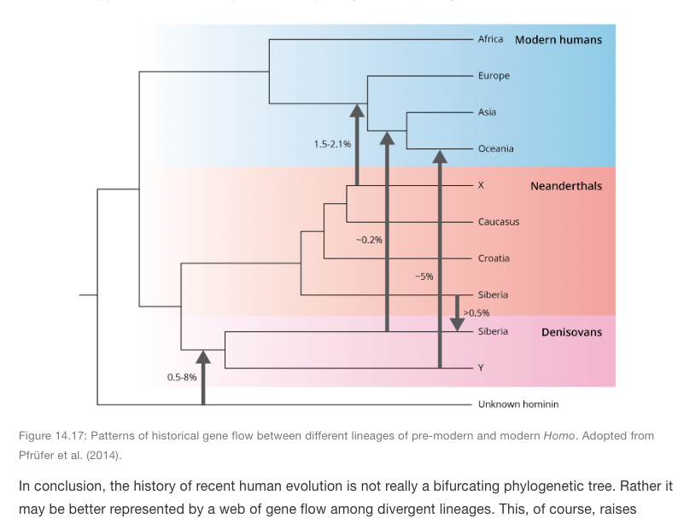
Depictions of groups of modern humans on branches of evolutionary trees are not supported genetically and support racism
A Primer of Evolution
An Introduction to Evolutionary Thought: Theory, Evidence, and Practice
Michi Tobler
https://michitobler.github.io/primer-of-evolution/human-evolution.html

Slide 17
Direct to consumer ancestry testing
  results depend on the samples/database used
  present results as definitive, not probability
  based on comparisons to modern populations, not ancestors
  algorithms assign ancestry based on calculated similarly to inferred ancestral population
  admixture implies mythological homogenous ancestral populations

Slide 18
Inferred ancestral population
Ancestry testing: is based on comparing costumer sequences to sequences of modern people from different geographic regions

Slide 19
Each individual of the sample is represented by a vertical line divided into colored segments with the length of each segment being proportional to the estimated membership in each of the inferred groups
https://stackoverflow.com/questions/41679888/how-to-group-order-data-in-r-for-a-barplot

Slide 20
MYTHOLOGICAL
Non-Darwinian estimation: my ancestors, my genes' ancestors.Weiss KM, Long JC.Genome Res. 2009 May;19(5):703-10. doi: 10.1101/gr.076539.108

Slide 21
Africa
Europe & Middle East
Asia
Pacific
America
Rosenberg et al. Science 298:2381-2385, 2002
A genetic classification of individuals based solely by molecular genotypes using the program STRUCTURE. Individuals were genetically clustered into 5 ancestral populations that also corresponded to 5 geographic regions (K=5).

Slide 22
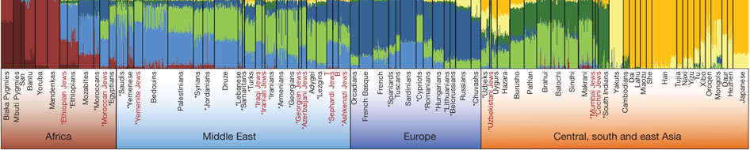
What happens to the clusters as you increase the geographical resolution?
Africa
Europe & Middle East
Asia
Pacific
America
Sharper boundaries,
less sampling, K=5
Rosenberg et al. Science 298:2381-2385, 2002
No sharp boundaries
Behar et al. Nature, 2010

Slide 23
What happens to the clusters as you increase the geographical resolution?
Africa
Europe & Middle East
Asia
America
Sharper boundaries,
less sampling, K=5
Pacific
Rosenberg et al. Science 298:2381-2385, 2002
Behar et al. Nature, 2010
No sharp boundaries
What does K really =?

Slide 24
Do any of these depictions provide evidence for racial groups?
What type of person are you? Old-fashioned thinking even in modern science.Weiss KM, Lambert BW.Cold Spring Harb Perspect Biol. 2014 Jan 1;6(1):a021238. doi: 10.1101/cshperspect.a021238.

Slide 25
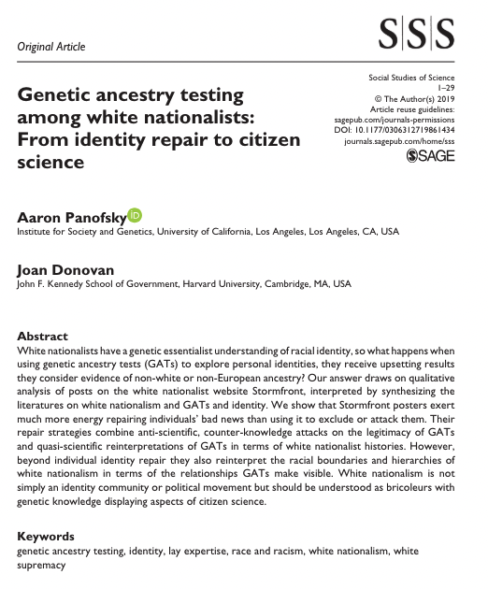

Slide 26
What about adaptive traits?
Adaptive traits:
Evolve in response to local selective pressures
Relatively new, compared to complex behavioral traits like intelligence

Slide 27
Adaptive traits don’t work either
Which trait? Not co-inherited, so groups change depending on what trait is chosen to define the group.

Slide 28
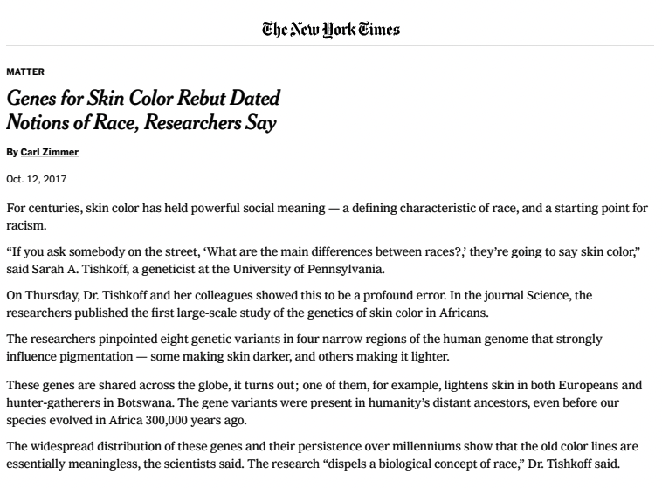

Slide 29
No gene/allele is uniform in any meaningful group
There are no genetically distinct human populations
  Even if you grouped people by a particular allele such that an allele was uniform, other alleles would not follow that distinction.
Most variation occurs within a group
Human evolution is a trellis, not a tree

Slide 31
Complex Genetics of skin color
Loci associated with skin pigmentation identified in African populations.
Crawford NG, Kelly DE, Hansen MEB, Beltrame MH, Fan S, Bowman SL, Jewett E, Ranciaro A, Thompson S, Lo Y, Pfeifer SP, Jensen JD, Campbell MC, Beggs W, Hormozdiari F, Mpoloka SW, Mokone GG, Nyambo T, Meskel DW, Belay G, Haut J; NISC Comparative Sequencing Program, Rothschild H, Zon L, Zhou Y, Kovacs MA, Xu M, Zhang T, Bishop K, Sinclair J, Rivas C, Elliot E, Choi J, Li SA, Hicks B, Burgess S, Abnet C, Watkins-Chow DE, Oceana E, Song YS, Eskin E, Brown KM, Marks MS, Loftus SK, Pavan WJ, Yeager M, Chanock S, Tishkoff SA.
Science. 2017 Nov 17;358(6365).

Slide 32
“There is so much diversity in Africans that there is no such thing as an African race.” Tishkoff
Bots. Bantu
Bots. SAN
Allele frequencies of OCA2 gene variant associated with skin color variation

Slide 33
Lactose metabolism: Another adaptive trait
Oct. 17, 2018
Why White Supremacists Are Chugging Milk (and Why Geneticists Are Alarmed)

Slide 34
Lactose metabolism: Another adaptive trait

Slide 35
Lactose metabolism: Another adaptive trait
Vs.
https://www.nature.com/scientificamerican/journal/v25/n4s/box/scientificamericanhumanity0916-100_BX2.html
Wikipedia

